Slide 1
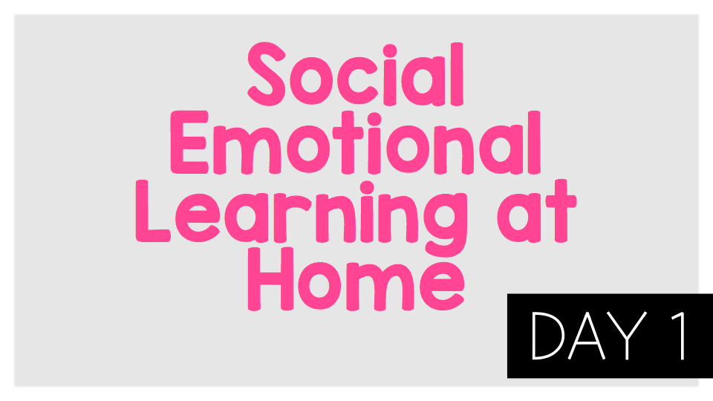

Slide 2
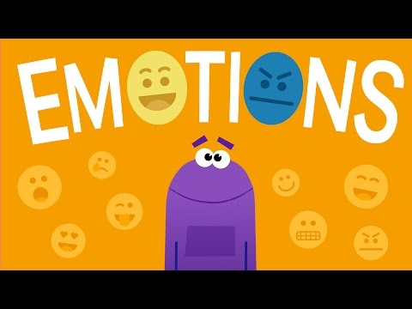
Think:
Which emotion are you feeling right now?
What can you do when you are feeling grumpy?
What can you do when you are feeling sad?
Do:
Make a list of all of the things that make you happy.

Slide 3

Activity:
Make a list of all the things that make you happy.

Slide 4
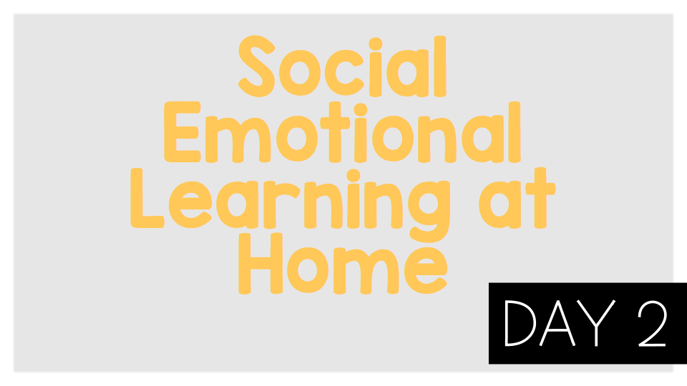
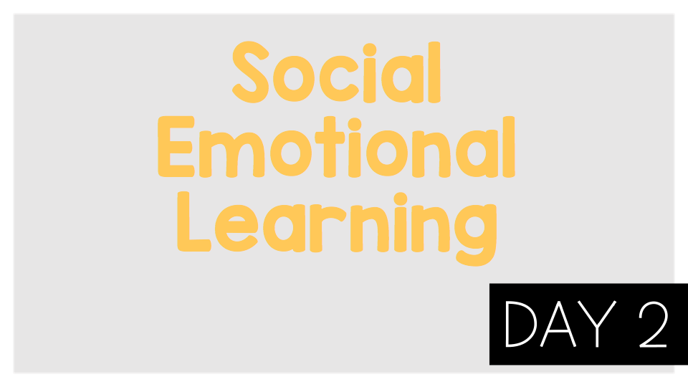
©TheSocialEmotionalTeacher

Slide 5
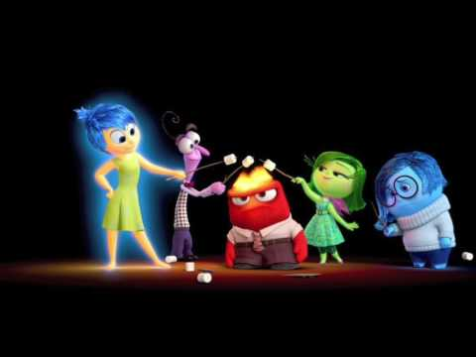
Think:
How does a person’s face change based on their emotion?
How does a person’s body change based on their emotion?
Which of these emotions are you feeling the most right now?

Slide 6
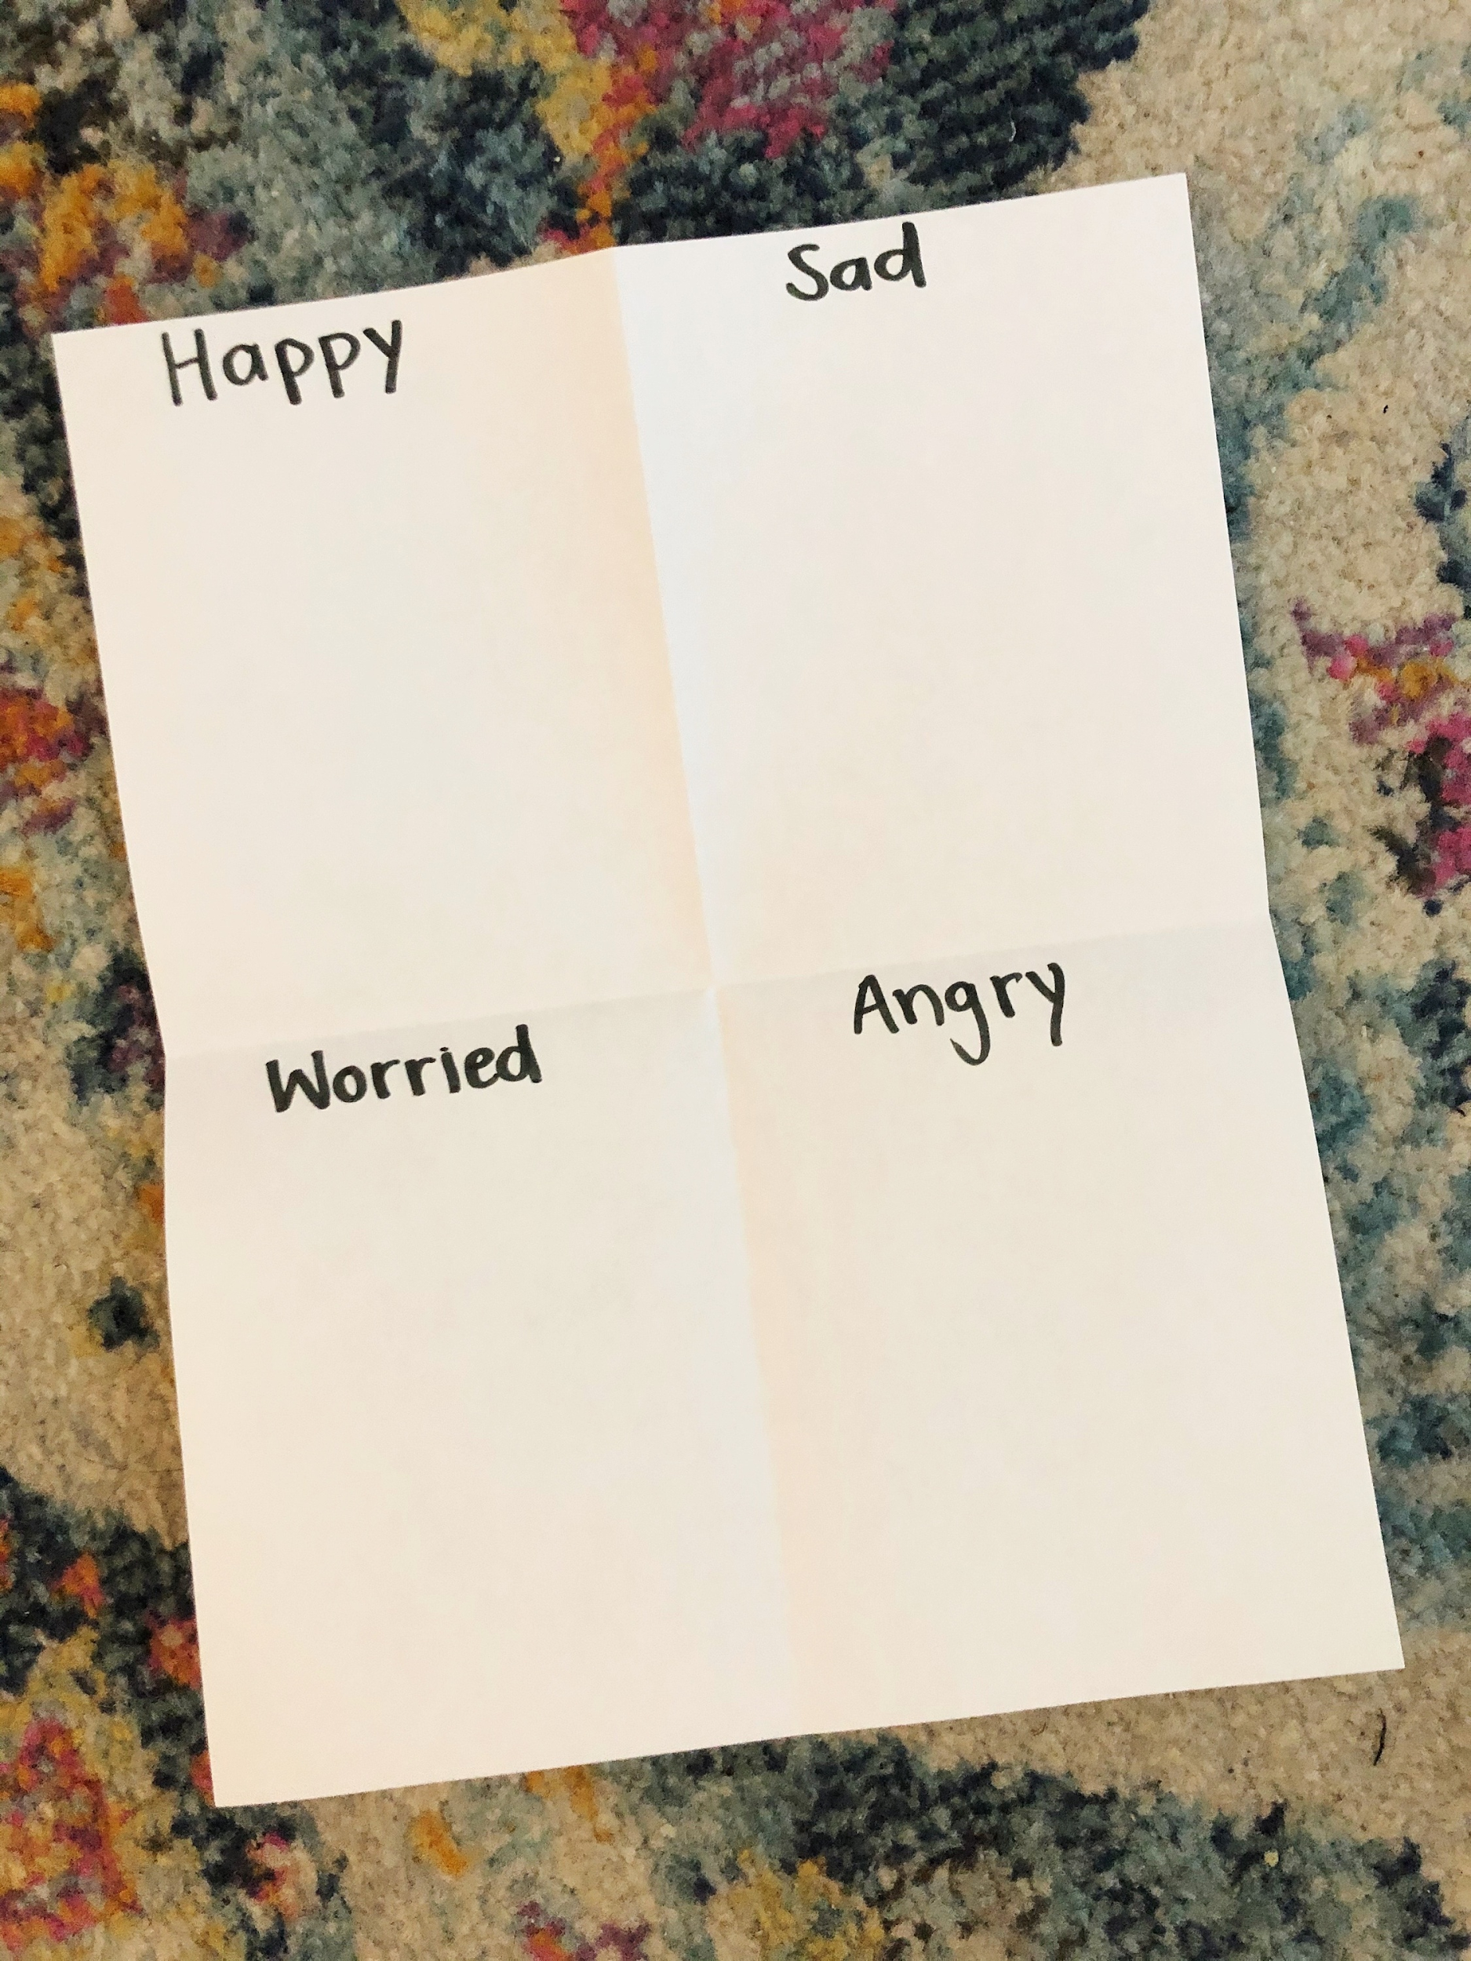
Activity:
Fold a piece of paper in half 2 times. Write one of the following emotions in each square: happy, sad, worried, angry. Draw a picture of yourself showing each emotion.

Slide 7
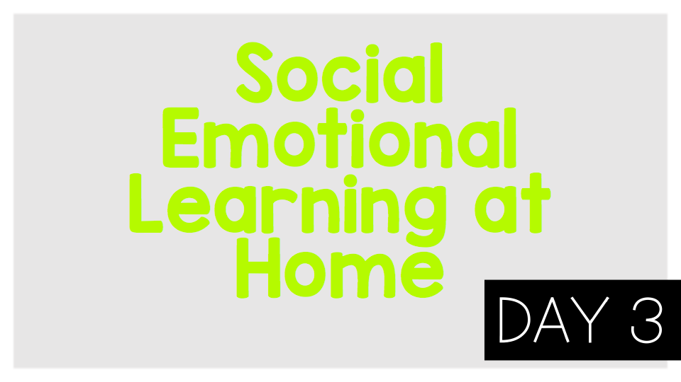
©TheSocialEmotionalTeacher

Slide 8
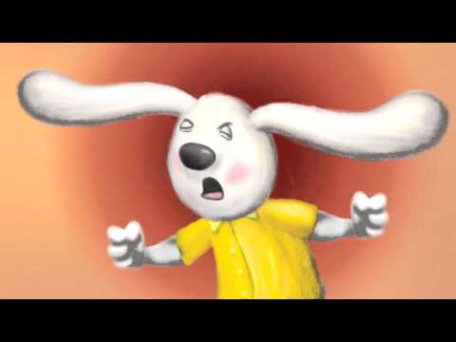
Think:
Have you ever felt like Howard?
How did Howard learn to listen to his body when it was angry?
What were some of the things Howard learned to do when his body felt angry?
What lesson can you learn from Howard?

Slide 9
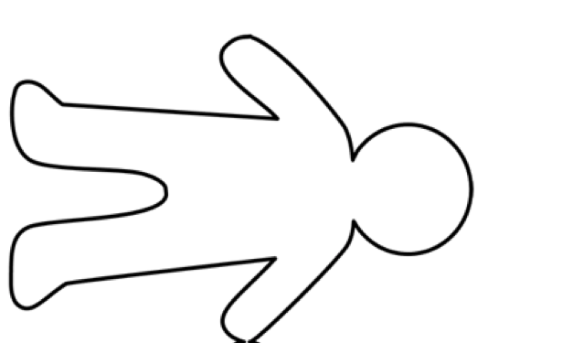
Activity:
Draw an outline of your body when it feels angry. Mark the parts where you feel the anger in red.

Slide 10
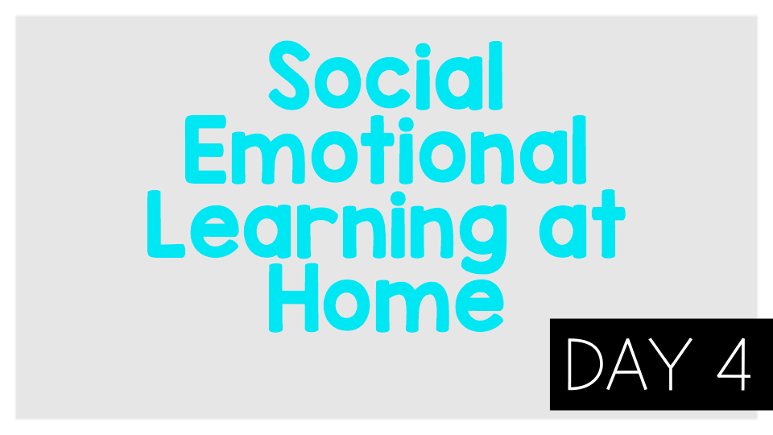
©TheSocialEmotionalTeacher

Slide 11
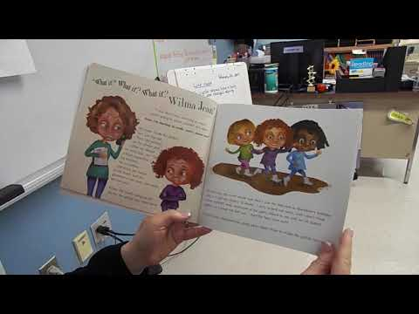
Think:
What are some of the worries Wilma Jean has? Can you relate to her worries?
What happens to Wilma Jean when she worries?
What did Wilma Jean’s teacher do to help Wilma Jean with her worrying?
Why is sorting our worries (like Wilma Jean’s teacher did) helpful?
Do:
Make a list of your worries.

Slide 12
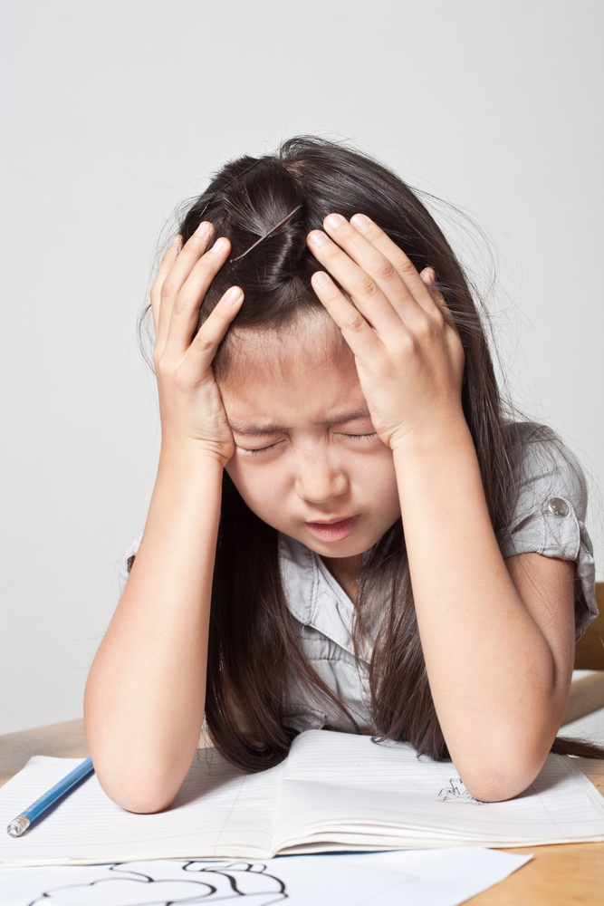
Activity:
Write/Draw something you worry about. Why do you worry about it? How does it affect your life? Can you control it? What are some steps to take to help with this worry?

Slide 13
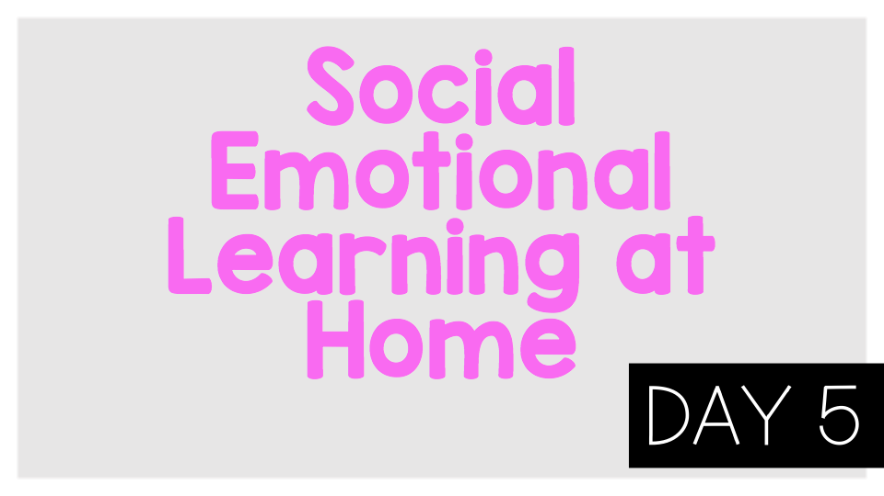
©TheSocialEmotionalTeacher

Slide 14
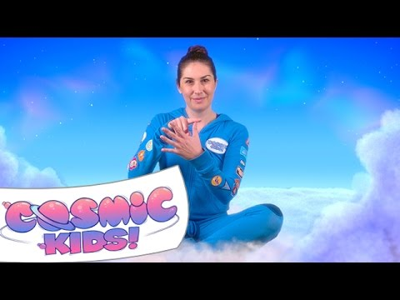
Think:
What are some things that make you feel nervous or worried?
What clever ways did you learn to balance the nervous feelings with calm feelings?
Do:
Practice the finger breathing strategy along with the video.

Slide 15
Activity:
Set a timer for 4 minutes. Think of ALL the things you feel worried about. Now practice the finger breathing exercise you learned in the video. How do you feel?

Slide 16

©TheSocialEmotionalTeacher

Slide 17
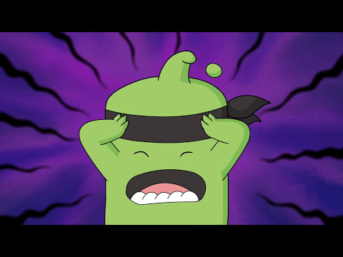
Think:
What is “the beast” in the video?
What made Mojo’s beast appear?
Think about a time you have experienced “the beast.”
Do:
Try the mindful breathing exercise on the next slide. Notice how you feel after.

Slide 18
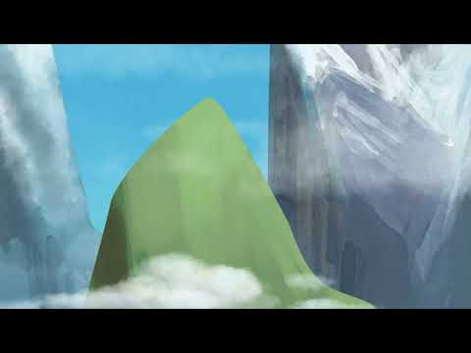

Slide 19
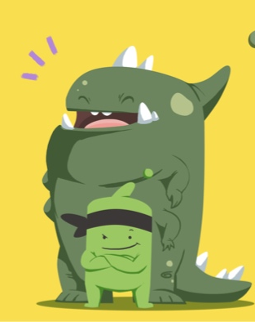
Activity:
Think about a time when your “beast” appeared. Draw a picture of your beast.

Slide 20

©TheSocialEmotionalTeacher

Slide 21

Think:
How do you feel about making mistakes?
Were you ever afraid of something but you did it anyway? What made you try something scary?
Beatrice “felt her stomach jumping around inside her.” How do you think she is feeling? How do you know?
In your opinion, which is more important: learning from your mistakes or being perfect?

Slide 22
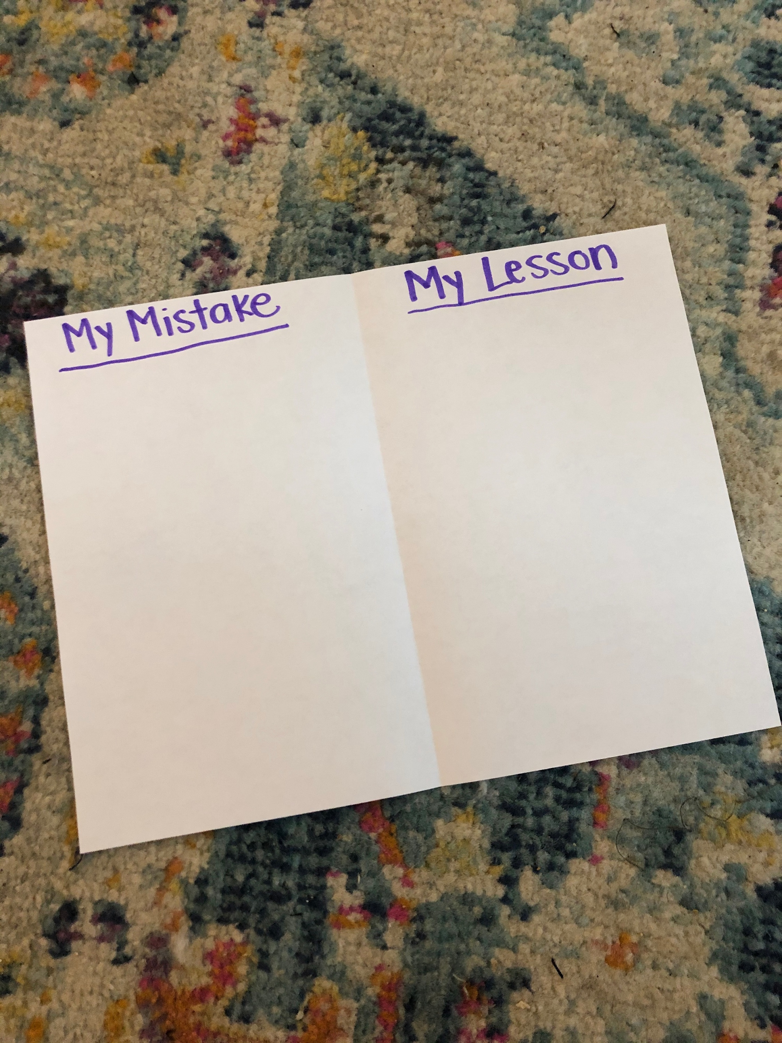
Activity:
Fold a piece of paper in half. On one side, draw or write about a mistake you have made. On the other side, draw or write the lesson you learned from your mistake.

Slide 23

©TheSocialEmotionalTeacher

Slide 24
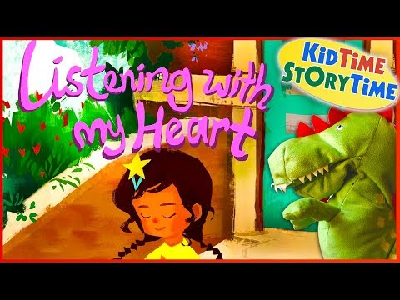
Think:
What is self-compassion?
Think about a time you have gotten mad at yourself.
Do you think it is easier to be kind to yourself or others? Why?
If you could talk to Esperanza after she runs off the stage, what would you say to her?
How can you spread love and kindness into the world?

Slide 25

Activity:
Write some kind words to yourself. This can be a letter, drawings of kind words, or positive statements. Say them out loud to yourself.

Slide 26

©TheSocialEmotionalTeacher

Slide 27
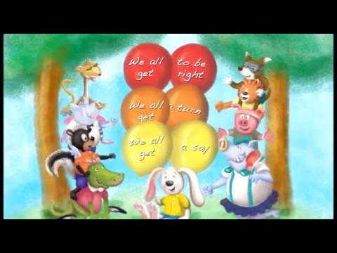
Think:
Did Howard know how to get along with his friends?
What did he learn from his grandma?
What are the 4 rules to get along with others?
Do:
Help Howard figure out how to help others get along at the end of the video.

Slide 28
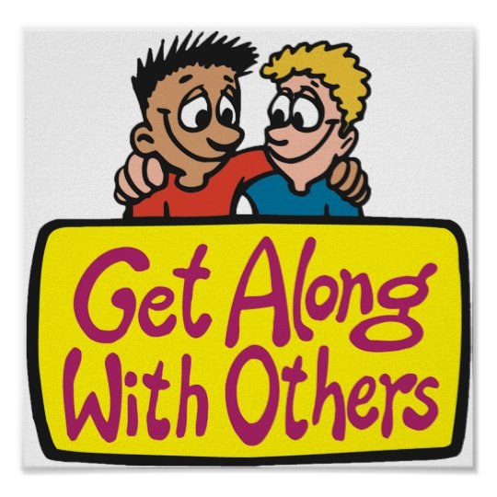
Activity:
Write/Draw about a time you used one of the 4 rules for getting along:
Review the Rules:
1.Everyone needs to have a say
2.Everyone needs to have a turn
3.Everyone gets to be right
4.Apologize

Slide 29

©TheSocialEmotionalTeacher

Slide 30
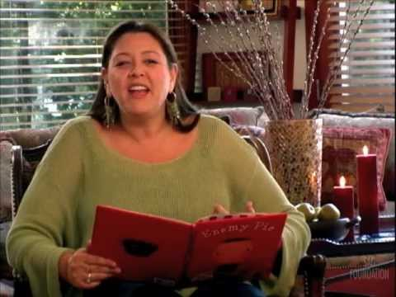
Think:
Why does the main character dislike Jeremy Ross?
How did the main character change as he spent his day with his neighbor, Jeremy?
What message or lesson can we learn from this book?
Did you ever have a similar problem as the main character?

Slide 31
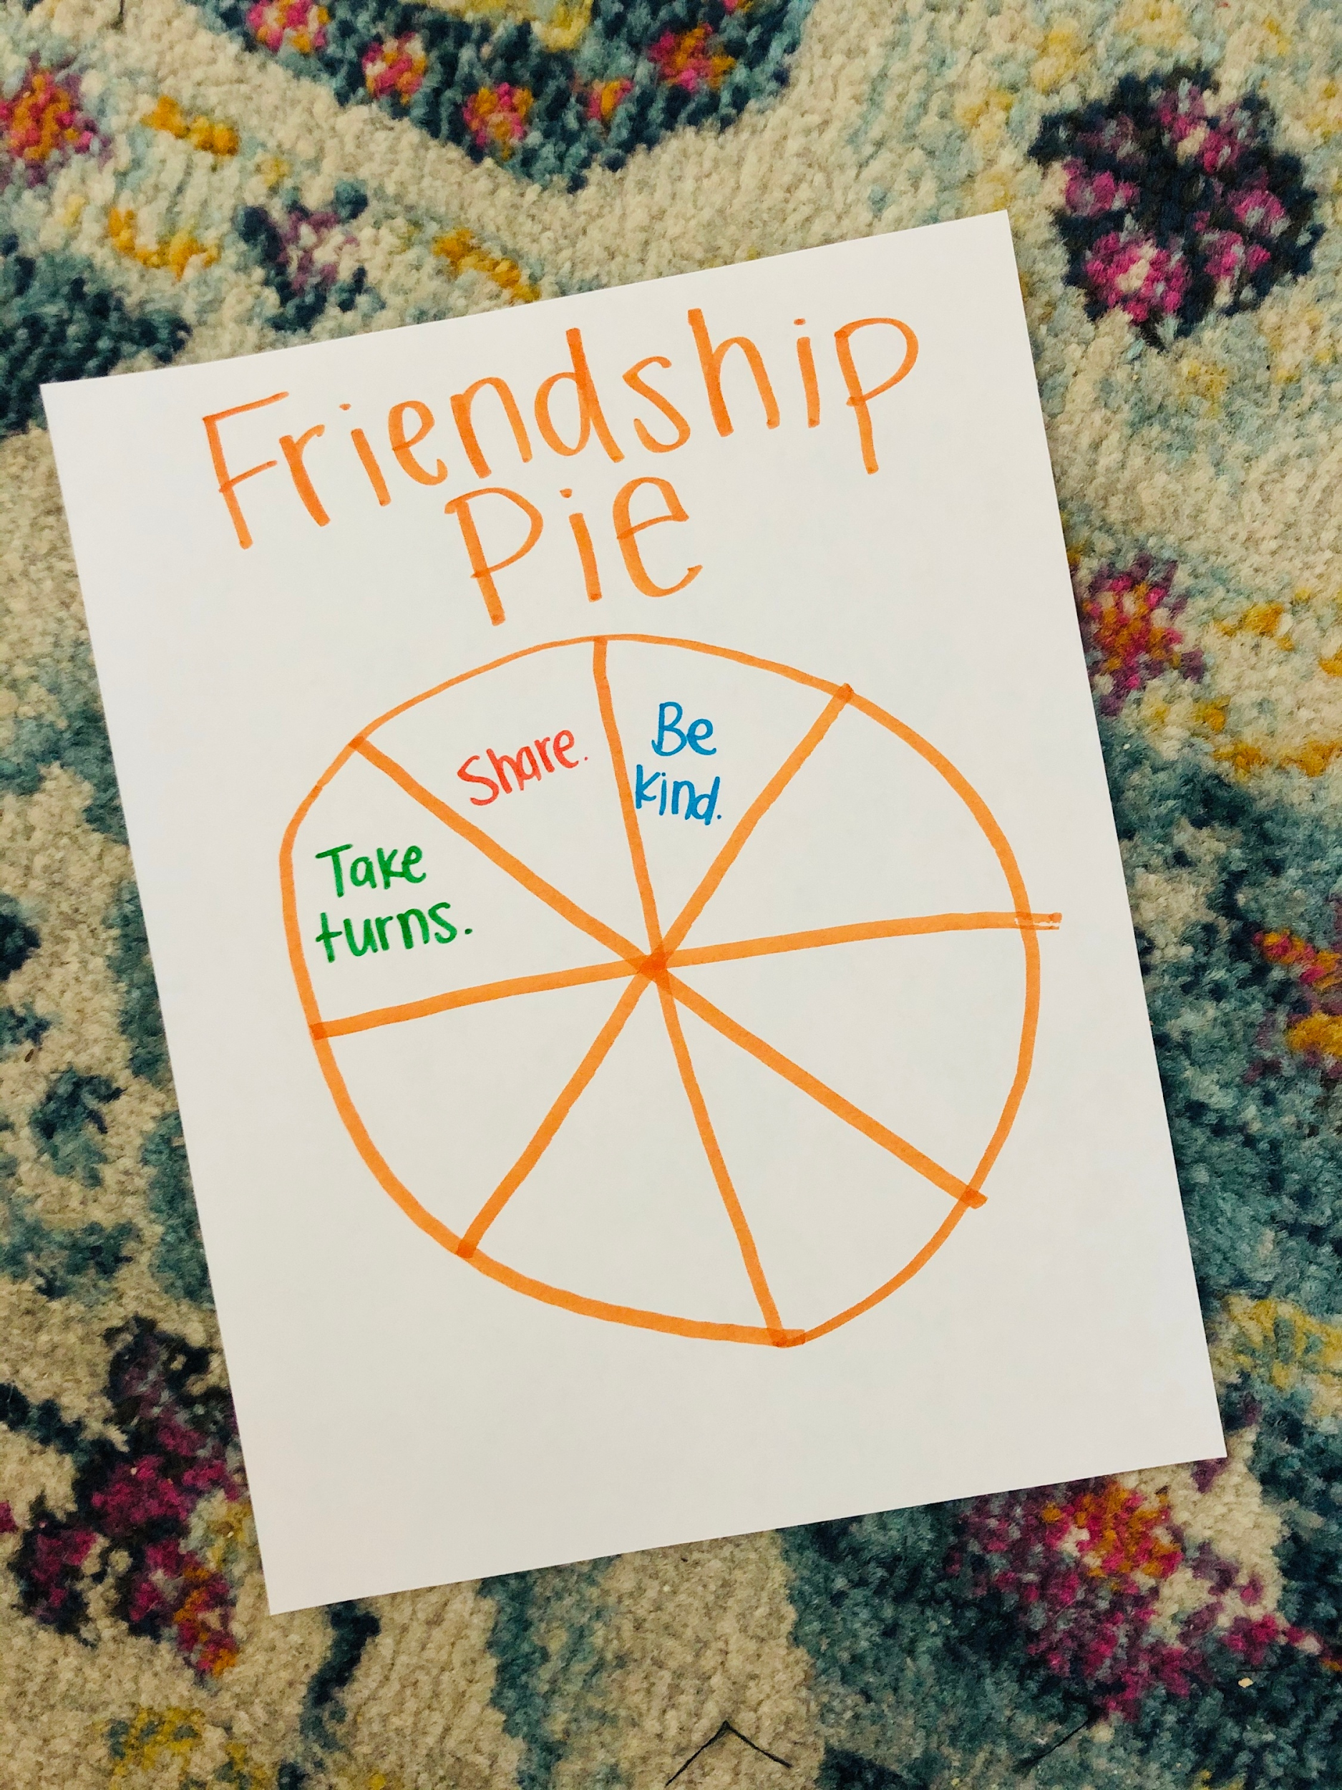
Activity:
Make a friendship pie. Draw a big circle on a piece of paper and divide it into sections. Write 1 way you can be a good friend in each section.

